Slide 1
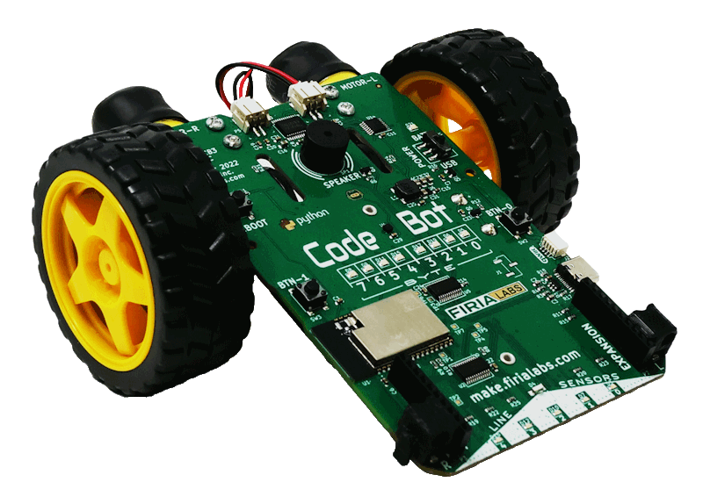
CodeBot Unit 1 Remix
Create your own project based on Missions 2 & 3

Slide 2

Time for a project remix!
A remix can be:
A new program created by adding new code to a program you already created
You can combine parts of two or more programs in a remix
Use a similar idea in a different way

Slide 3
Project Remix
Creating a remix will let you:
Improve your skills and practice the concepts from the mission.
Be creative.
Remember code from earlier programs and missions.
Work with other students.
Design an original program and write the code all on your own.

Slide 4
Step #1
Review Mission 2
Open your program from Mission 2
LightsOn
Review the mission log from Mission 2
DO THIS:
Fill out the information in the Planning Guide for Step 1

Slide 5
Step #1
Review Mission 3
Open your programs from Mission 3
SequenceLEDs
BinaryLEDs
NavSquare
WhatIf
Review the mission logs from Mission 3
DO THIS:
Fill out the information in the Planning Guide for Step 1

Slide 6
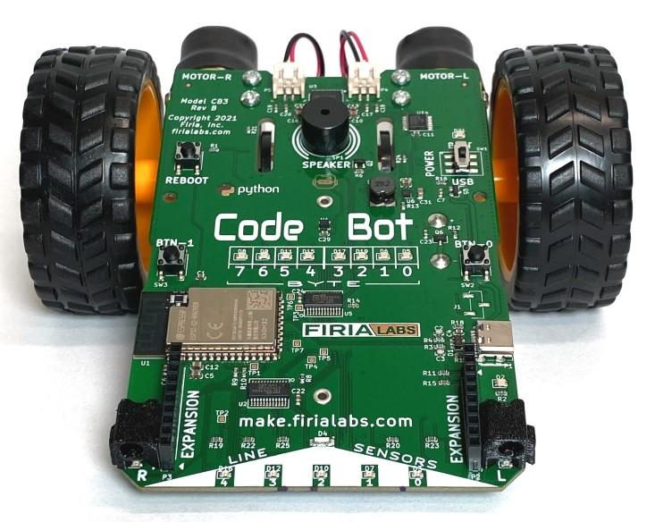
Step #2
Brainstorm ideas
For this project, you will decide what CodeBot will do.
While you were working on the programs for these missions, did you ever have your own ideas, or wonder “what if”?
If so, this is your chance!
If you already have your own idea, you are good to go.
If not, read some of the suggestions on the next slide. You can use one of them, or use them as inspiration for your own idea.

Slide 7
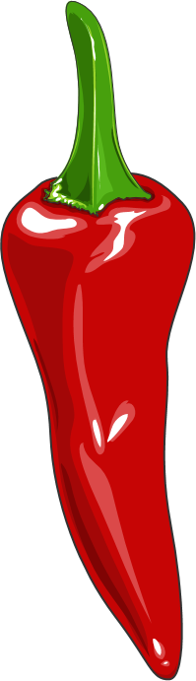
Step #2 Remix Ideas
Mild
Have the choice of CodeBot moving in a large square or a small square. Use LEDs to indicate the choice. Use button presses for the selection.
Mild
Use a button press to move the ‘bot in a pattern with forwards and rotations. Use a different button press to display a light show with LEDs.

Slide 8
Step #2 Remix Ideas
Medium
Program the ‘bot like a remote control – when one button is pressed, it moves one way, and a different way for the other button. Include LEDs.
Medium
Program the ‘bot to move in two different shapes (square, rectangle, triangle, circle, etc.). Use a button press to select a shape. Use LEDs to indicate which shape was selected.

Slide 9
Step #2 Remix Ideas
Spicy
Use a button press to move the ‘bot in a particular pattern with forwards and turns. Use a different button to move it a different pattern with forwards, backwards and turns. Light up different LEDs as the ‘bot moves, to indicate what the movement is. For example, light up user LEDs when moving forward, and line sensor LEDs when moving backward, and a combination when rotating.
Spicy
Program the ‘bot to do a dance, with movement and lights. Code two different dances, and use a button press to select a dance.

Slide 10
Step #2
Brainstorm ideas
Read through remix suggestions.
Use the suggestions –or–
Use your creativity to come up with your own idea for a project.
Decide what project you will do.
DO THIS:
Fill out the information in the Planning Guide for Step #2

Slide 11
Step #3
Make a plan
Write an algorithm for your project.
Think about the tasks for the program.
Think about the steps it will take to complete the tasks.
Make a step-by-step plan.
What happens first?
What happens next?
What happens with each button press?
DO THIS:
Fill out the information in the Planning Guide for Step #3

Slide 12

Step #4
Code your project
IMPORTANT: In CodeSpace, go to the sandbox
Start a new file and give it a descriptive name (Remix1)
You can leave other programs open and use them as a guide
Import your libraries
Define your variables
Write your code a little bit at a time, testing frequently (divide and conquer!)

Slide 13
Step #4
Stop and test frequently!
Don’t try to write all the code at one time
Think about the steps:
Just get one thing to work, then move on
Step by step!
Mistakes happen, so find them early
Type just a few lines of code and then run the program
If there is an error, fix it before continuing
Use your other programs and classmates for help

Slide 14
Step #4
Documentation!
Make sure your code is readable by adding blank lines
Add comments to sections of your code that explain what they do

Slide 15
Step #5
Get feedback and Revise
Show your code to other students.
What do they think? Have them fill out the feedback form on your Planning Guide.
The Planning Guide has space for two people to give feedback. The feedback can come from two peers or one peer and yourself.
Use the peer reviews to modify your code and make your project even better

Slide 16

And now you have your own remix!
Congratulations!
By completing this remix you have:
learned more about programming
practiced the skills and concepts from the missions
been thinking! And problem solving and much more!

Slide 17

Mission Reflection
Wow! Great job!
Share your project with your friends!
Run projects from other students
Complete the Post-Remix Reflection in the Planning Guide

